Slide 1
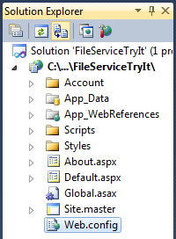
ASP.Net Application and Its Components
ASPX files containing Web forms
ASCX files containing user controls
Web.config files containing configuration settings
A Global.asax file containing global application elements
DLL (dynamic link library) files containing custom types employed by the application

Slide 2
Web.config File
.Net supports XCOPY deployment: Install software by simply drag and drop the software folder, uninstall software by deleting the folder;
Keep the text-based configuration file with the application, instead of putting it in the system registry.
Every Web application automatically includes a Web.config file;
The file is never locked when the application is running, and it can be edited at any time;
The files is transferrable to other applications: simply copy and paste;
The file is easily readable for both human and machine

Slide 3
Web.config File
Web.config file is an XML file
It controls various settings. including
Application data and parameter values
Communication protocols
Authentication and authorization setting (to be discussed in chapter 6)
configuration
appSettings
system.web
. . .
. . .
. . .
. . .
. . .
. . .
. . .

Slide 4
Web.config File
configuration
appSettings
system.web
. . .
<?xml version = “1.0” ?>
<configuration>
<configurations> </configurations>
<appSettings> <!-- appSetting here --> </appSettings>
<connectionStrings> <!-- cS setting --> </connectionStrings>
<system.web>
<!--ASP.Net configuration settings -->
<system.web>
<system.codedom> <!-- setting --> </ system.codedom>
<system.webServer> <!-- setting --> </ system.webServer>
<configuration>

Slide 5
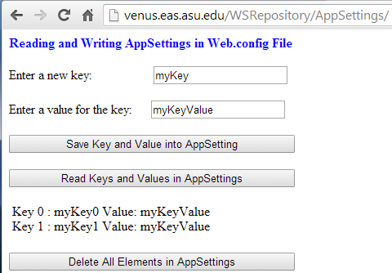
Reading & Writing AppSettings in Program
http://venus.eas.asu.edu/WSRepository/AppSettings/
Data stored in AppSettings can be accessed in the program.
There are different ways of accessing the data;
Example: Design a Web Site App to Modify appSettings

Slide 6
Code Behind the Page: Write
protected void btnSave_Click(object sender, EventArgs e) {
System.Configuration.Configuration config =
System.Web.Configuration.WebConfigurationManager.
OpenWebConfiguration("~/"); // Open Web.config file
// Create a new element into appSettings.
int index =
System.Configuration.ConfigurationManager.AppSettings.Count;
string newKey = txtKey.Text + index.ToString();
string newValue = txtValue.Text;
// Modify the appSettings in Web.config file.
config.AppSettings.Settings.Add(newKey, newValue);
// Save the changes into the Web.config file.
config.Save(System.Configuration.ConfigurationSaveMode.Modified);
}
Open the Web.config file
Add the new pair into AppSettings
Save the changes

Slide 7
Code Behind the Page: Read
protected void btnRead_Click(object sender, EventArgs e)
{
System.Collections.Specialized.NameValueCollection myKeys =
System.Web.Configuration.WebConfigurationManager.AppSettings;
lblDisplay.Text = "";
for (int i = 0; i < myKeys.Count; i++)
{
string appEntry = String.Format("Key {0}: {1} Value: {2} <br/>",
i, myKeys.GetKey(i), myKeys[i]);
lblDisplay.Text += appEntry;
}
}
Create an object of AppSettings
Formating the AppSettings object for display

Slide 8
Code Behind the Page: Delete
protected void btnDelete_Click(object sender, EventArgs e)
{
XmlDocument myCF = new XmlDocument();
myCF.Load(AppDomain.CurrentDomain.SetupInformation.ConfigurationFile);
foreach (XmlElement appElement in myCF.DocumentElement)
{
if (appElement.Name.Equals("appSettings"))
{
appElement.RemoveAll();
lblDisplay.Text = "All AppSettings elements are removed";
}
}
myCF.Save(AppDomain.CurrentDomain.SetupInformation.ConfigurationFile);
}
Use XmlDocument class
Find appSettings element
Remove all child elements
Save the file

Slide 9
Policy-Based Computing
Policy-based computing refers to a software development model that incorporates a set of decision-making parameters into a separate management component (called policy data store or policy-base) in order to simplify and automate the administration of computer systems;
Policies are items returned from a policy data store and used at runtime by application software. Examples of policies:
Password must use between 8 and 12 characters AND a mix of letters and digits.
Door unlock at 7am and lock at 6pm
Instead of hard coding the specific parameter values into the program, the values are stored in policy data store, which can be modified while the processing program is running.

Slide 10
Using <appSettings> vs. Hard Coding
The purpose is to parameterize an application’s behavior, and to allow the behavior to be modified without changing & recompiling the source code.
<appSettings> section holds the application specific values (strings) that can be read during execution.
The basic form of policy-based computing.
Example: Hard-coded SQL access string
SqlDataAdapter adapter = new SqlDataAdapter
(“select * from titles where price != 0”,
“server=hawkeye; database=pubs; uid=sa; pwd=”);
DataSet ds = new DataSet ();
adapter.Fill (ds);
Hard coded
Hard coded
Hard coded

Slide 11
Example: Store Custom Setting in <AppSetting>
<appSettings>
<add key= “xDataFile” value= “c:\myAspApps\Docs\xmlDoc=” />
</appSettings>
Public partial class myApp : System.Web.UI.Page
{
protected void Page_Load( );
{
lblResult.Text = “Display data in xmlDoc here: <br />”;
lblResult.Text += WebConfigurationManager.appSettings[“xDataFile”];
lblResult.Text += “<br />”
}
}
Supporting policy-based computing.

Slide 12
Using <appSettings> instead of Hard Coding
String conn = ConfigurationSettings.appSettings[“MyConnectionString”];
SqlDataAdapter adapter = new SqlDataAdapter
(“select * from titles where price != 0”, conn);
DataSet ds = new DataSet ();
adapter.Fill (ds);
Page_Load extracts the connection string from the Web.config file
<configuration>
<appSettings>
<add key= “MyConnectionString” value=
“server=hawkeye;database=pubs;uid=sa;pwd=” />
</appSettings>
</configuration>

Slide 13
<system.web> Element
system.web
The system.web section of Web.config holds configuration settings used by the system -- ASP.NET.
Its content is categorized by subsections. Developers are free to define custom subsections.
The following subsections are supported by default and can be used without writing custom configuration handlers.
authentication Sets the authentication mode and specifies settings for the mode selected
authorization Specifies who is allowed to access resources in this directory and its subdirectories
browserCaps Maps user-agent data to browser capabilities
clientTarget Maps user-agent data to browser types
compilation Specifies run-time compilation settings such as whether executables should be compiled with debug symbols, maps file name extensions and Language attributes to compilers, and identifies the assemblies that ASP.NET links to

Slide 14
<system.web> Element -- continued
customErrors Enables the use of custom error pages and specifies how errors should be reported on clients and servers
httpRuntime Specifies request time-outs and other settings used by ASP.NET runtime
globalization Specifies character encodings for requests and responses
httpHandlers Maps URLs to HVFP handlers (for example, maps requests for ASPX files to System. Web.UI.PageHandlerFactoiy)
httpModules Identifies HTTP modules called in response to HUP requests
identity Controls the identity that ASP.NET assigns to individual requests
machineKey Specifies encryption and validation settings (for example, the key and algorithm used to encrypt authentication cookies)
pages Specifies page-level configuration settings such as whether output buffering, session state, and view state are enabled
processModel Specifies configuration settings for ASP.NET worker processes
securityPolicy Maps trust levels to CONFIG files containing security policies
sessionState Specifies session state settings (e.g., where session state is stored)
trace Enables and disables tracing and specifies trace settings
trust Specifies the code access security trust level
webControls Identifies the location on the server of client scripts used by ASP.NET Web controls
webServices Contains Web service settings

Slide 15
Example of <system.web> Element
<configuration>
<system.web>
<trace enabled=“true” I>
<Isystem.web>
</configuration>
Empty element
<configuration>
<system.web>
<trace enabled=“true” />
<sessionState mode=“SQLServer” sqlConnectionString=“server=localhost;uid=sa;pwd=”/>
<compilation debug=“true” defaultLanguage=“c#” />
<pages enableViewStateMac=“true” />
</system.web>
</configuration>

Slide 16
Example of <system.web> Element
Allow the .asmx Web service test page to be accessed remotely.
<system.web>
. . .
<webServices>
<protocols>
<add name="HttpGet"/>
<add name="HttpPost"/>
</protocols>
</webServices>
</system.web>

Slide 17
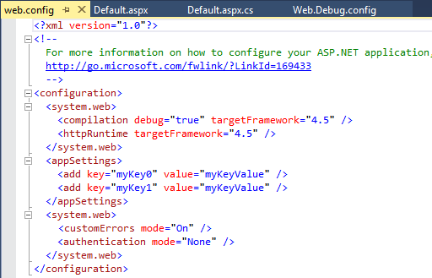
Debugging Information in Web.config File
Remove the targetFramework 4.5 if the server does not support this version, and the compiler throws an error.

Slide 18
Web Configuration File Inheritance
ASP .Net root
web
.config
machine
.config
inherit
MyWebApp
<configuration>
<system.web>
<compilation
defaultLanguage=“c#”/>
</system.web>
</configuration>
Global
.asax
web
.config
.aspx
files
.ascx
files
.aspx
files
.aspx
files
.aspx
files
.aspx
files
<configuration>
<system.web>
<compilation defaultLanguage=“vb”/>
</system.web>
</configuration>
inherit
CSHARPFILES
VBFILES
inherit
.aspx
files
.aspx
files
web
.config
.aspx
files
.aspx
files
.aspx
files
.aspx
files
override

Slide 19
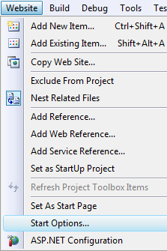
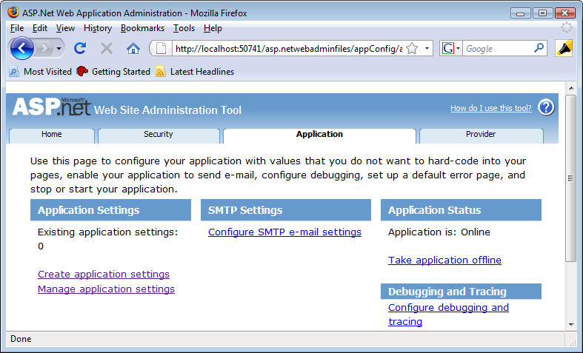
Using ASP.Net Website Admin Tool
In VS, select Website → ASP.Net Configuration

Slide 20
Outline: Structure of ASP.Net Application
ASPX files containing Web forms
ASCX files containing user controls
Web.config files containing configuration settings
A Global.asax file containing global application elements
DLL (dynamic link library) files containing custom types employed by the application
Cookies
Session State

Slide 21
Global.asax File
Global.asax is a text file that houses global directives, application-level event handlers, declarations that apply to all parts of the application, and other global application elements.
Global directives
@ Application directives
@ Import directives
@ Assembly directives
Global event handlers: particularly important and are the main reason why developers include Global.asax files in their applications
Global objects (variables)

Slide 22
@ Application Directives in Global.asax
@ Application directives serve two purposes:
Enable developers to add descriptive text (comments) to applications, and
Facilitate programming in Global.asax files.
<%@ Application Description = “MY ASP.NET Application with Global Directives” %>
<%@ Import Namespace= “System.Data” %>
<script language=“C#” runat=“server”>
void Application_Start ()
{
DataSet ds = new DataSet ();
ds.ReadXml (Server.MapPath (“GlobalData.xml”));
Application[“GlobalData”] = ds;
}
</script>
Support DataSet
This code will be compiled at runtime:
Pro: flexibility
Con: cold start

Slide 23
@ Application Directives in Global.asax
Write the code as a C# program (.cs) and pre-compile the code into .DLL file, e.g., MyStarter.dll
using System.Web;
using System.Data;
public class MyStarter : HttpApplication
{
void Application_Start ()
{
DataSet ds = new DataSet ();
ds.ReadXml (Server.MapPath (“GlobalData.xml”));
Application[“GlobalData”] = ds;
}
}
In Global.asax file, use this line to invoke the program
<%@ Application inherits = “MyStarter” %>

Slide 24
Global Event Handlers in Global.asax
ASP.NET fires global events named Start and End, when an application starts and stops. To process these events, include handlers named Application_Start and Application_End in Global.asax:
<script language=“C#” runat= “server”>
void Application_Start()
{
. . . // Display Welcome message, initialization, …
}
void Application_End()
{
Response.Write(“<hr />This page was last accessed at ” + DateTime.Now.ToString());
}
</script>

Slide 25
Additional Application Events
There are many other application events that you can handle by writing your handlers:
Event/handler Description
Application_Start( ) Called the beginning of the application
Application_End( ) Called the end of the application
Session_Start( ) Called the beginning of the session
Session_End( ) Called the end of the session
Application_Error( ) Called when an unhandled error occurs

Slide 26
Per Request Event Handlers
Application_BeginRequest( ) Called at the beginning of each request the
appl. received, before the page is executed;
Application_EndRequest Called after the page is executed at the end
of each request the application received;
Application_AuthenticateRequest( ) Called to authenticate the caller
Application_AuthorizeRequest( ) Called to determine whether the caller is authorized to access the requested resource
Application_ResolveRequestCache( ) Called to resolve the current request by providing content from a cache
Application_AcquireRequestState( ) Called to associate the current request with a session and populate session state
Application_ReleaseRequestState( ) Called to release (store) any State associated with this session
Application_UpdateRequestCache( ) Called to update a cache with content
returned in the response

Slide 27
Global Object / Variable in Global.asax
A global object/variable can facilitate the communication among the
Different sessions from different clients
Pages within the same session (There are other better ways for this purpose: session state)
Need to address the monitoring/synchronization issues, as we discussed in Chapter 2.

Slide 28
Global Object / Variable
Challenge 1: Simultaneous write?
In Global.asax file
<script language=“C#” runat=“server”>
public static Int32 globalCounter = 0;
</script>
<script language=“C#” runat=“server”>
private static Int32 globalCounter = 0;
public void increment(Int32 newValue) {
lock(this) {
globalCounter = globalCounter + newValue;
}
</script>
Challenge 2: Performance?

Slide 29
Files in an ASP.Net Web Application
MyWebApp
Global
.asax
Web
.config
Dynamic Linking Library
Files
.aspx
files
.ascx
files
.aspx
files
.aspx
files
.aspx
files
.aspx
files
Subdir 1
Subdir 2
bin
.dll
files
.aspx
files
.aspx
files
Web
.config
.aspx
files
Web
.config
.aspx
files
.aspx
files
.aspx
files
.aspx
files
.aspx
files

Slide 30
Creating DLL Components
An application can contain multiple classes (pages);
The code of the classes (aspx.cs files) are not reusable in other applications;
The .aspx.cs file provides event handlers for the controls in aspx page;
In order to reuse the code, you can make this component a service – a remote component;
You can also create your own DLL library to collect all your reusable classes. They are local components and have better performance.
Your library will form a namespace;
Include your library in your application.

Slide 31
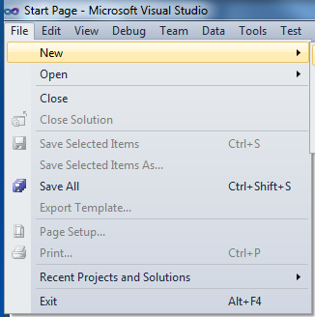
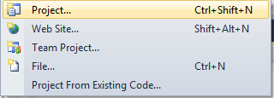
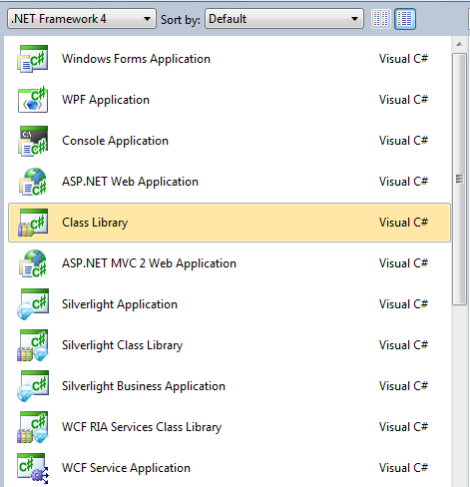
Creating a Class Library Project

Slide 32
Add the DLL File into your Web Project
Create a new project of type "Class Library“;
Create a .cs page of classes that you will be using in your other applications.
After classes are created and compiled, go back to your website project and do "Add Reference”;
Browse to the class library project, find the library, and add it to your application project.
A copy of the DLL file will be placed in the "bin" directory in your application folder.

Slide 33
Create myLibrary in Class Library Project
namespace myLibrary{
public class TemperatureConversion {
public static Int32 getFahrenheit(Int32 c) {
Double f = c * 9 / 5 + 32;
return Convert.ToInt32(f);
}
public static Int32 getCelsius(Int32 f) {
Double c = (f - 32) * 5 / 9;
return Convert.ToInt32(c);
}
}
public class myMath {
public static long abs (long x) {
if (x >= 0) return (x); else return (-x);
}
}
}
Class 1
Class 2

Slide 34
Use the Functions in myLibrary
Include myLibrary
Add Reference to copy the code into the application.
using myLibrary;
class myApplication {
static void Main(string[ ] args) {
Int32 Ctemp = 23;
Int32 Ftemp = 121;
double x = TemperatureConversion.getFahrenheit(Ctemp);
double y = TemperatureConversion.getCelsius(Ftemp);
System.Console.WriteLine(“C-temp {0} is F-temp {1}", Ctemp , x);
System.Console.WriteLine(“F-temp {0} is C-temp {1}", Ftemp , y);
}
}
Class Name
Method Name
double x = myLibrary.TemperatureConversion.getFahrenheit(Ctemp);

Slide 35
Wrapping Legacy Software into Web Service
There are many useful software components are developed before Web service standards;
They are in the form of library classes and functions, such as DLL classes and functions;
To wrap a library class into a service:
Use a Web service template to start service development;
Add Reference and load a library class into your service;
Use the library class to implement your service interface;
After you deploy the service, the library class becomes a service;
You may need re-implement a number of mechanisms, such as input, output, and state management.

Slide 36
Chapter 5 Outline: Application Building
Web Computing Models
Web Application Architecture
Web Application Controls and Components
Server Controls (HTML and Web Controls)
User Controls
Web Configuration
Global Control
DLL
Web Application State Management
Cookies
Session State, Application State
Server side file system
Dynamic Graphics, Animation, Mobile Computing
L20

Slide 37
Cookies: Storage on Client Computer
Cookies provide a way of storing user’s information
in the browser (temporary, disappear after closing browser)
on the hard drive of client’s computer (longer term)
Cookies are transparent to the users, as long as the cookies are enabled in the browser;
Cookies can store string type of data only, often used for storing user’s preferences of the application;
Other data types need to be converted to strings;
The syntax of Cookies are similar to View State.

Slide 38

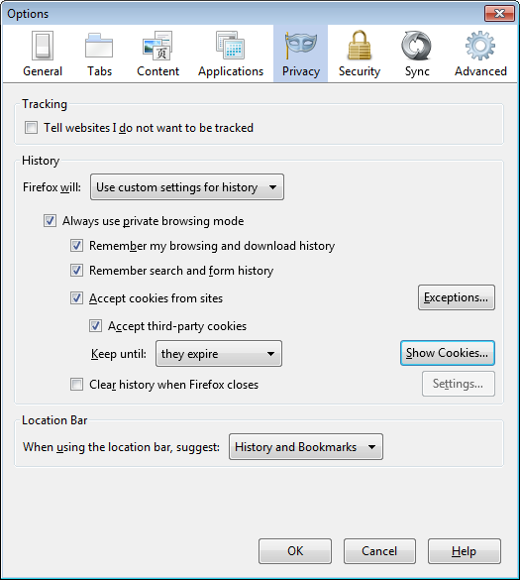
Configure Your Browser to Enable Cookies

Slide 39
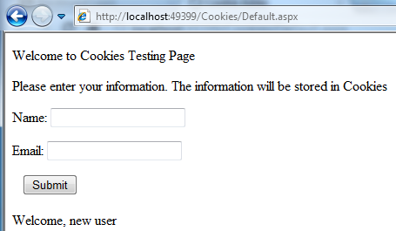
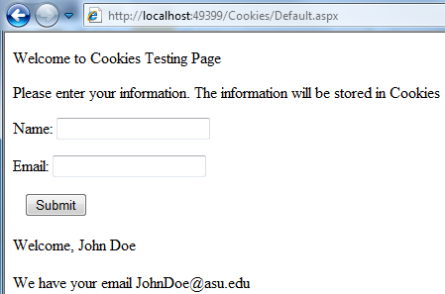
Testing a Website with cookies: (1) Enter data (2) Close Browser (3) Reopen
Demo
http://venus.eas.asu.edu/WSRepository/CookiesTest/
Close the page and re-open the page
John Doe
John.Doe@asu.edu

Slide 40
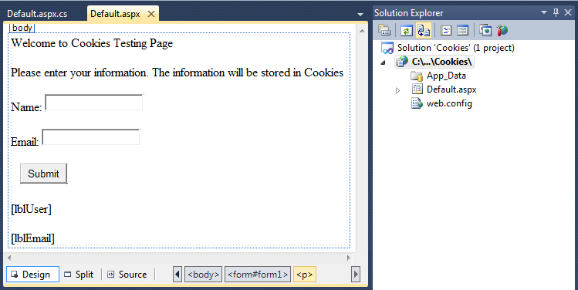
Page Design

Slide 41
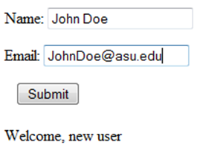
Code Saving and Retrieving Cookies
Create a new cookie object with a key
protected void Button1_Click(object sender, EventArgs e)
{
HttpCookie myCookies = new HttpCookie("myCookieId");
myCookies["Name"] = TextBox1.Text;
myCookies["Email"] = TextBox2.Text;
myCookies.Expires = DateTime.Now.AddMonths(6);
Response.Cookies.Add(myCookies);
lblUser.Text = "Name stored in cookies " + myCookies["Name"];
lblEmail.Text = "Email stored in cookies " + myCookies["Email"]; }
}
Add my content to the cookies collection
Read the content and display at the given label

Slide 42
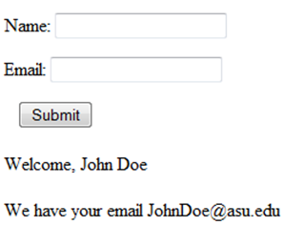
Code Saving and Retrieving Cookies
Access a cookie object using a key
using System.Net; // needed for Cookies
public partial class _Default : System.Web.UI.Page {
protected void Page_Load(object sender, EventArgs e) {
HttpCookie myCookies = Request.Cookies["myCookieId"];
if ((myCookies == null) || (myCookies["Name"]=="")) {
lblUser.Text = "Welcome, new user";
} else {
lblUser.Text = "Welcome, " + myCookies["Name"];
lblEmail.Text = "We have your email " + myCookies["Email"];
}
}
// continued on next page
Check if the cookie exist or is empty
Read cookie content and display at given label

Slide 43
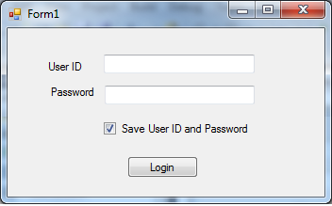
Application of cookies in Login
Cookies are often used in saving the credentials

Slide 44
Code behind the Login Button
namespace LoginCookie {
public partial class LoginPage : Form {
public LoginPage()
{ InitializeComponent(); }
private void btnLogin_Click(object sender, EventArgs e) {
if ((txtUserId.Text != "") && (txtPassword.Text != ""))
{
String c = txtUserId.Text + “ ” + txtPassword.Text;
FormsAuthentication.RedirectFromLoginPage(c, ckbChecked);
}
else
Output.Text = "Invalid login, try again";
}
}
}
This method will compare the user ID and the password saved in Web.config file. To discuss in Chapter 6.

Slide 45
FormsAuthentication.RedirectFromLoginPage
FormsAuthentication.RedirectFromLoginPage (txtUserId.Text, Persist);
true: create cookies to save the credential
false: no cookies for the credential
Applications of cookies will be further discussed in later section and in chapter 6 on security

Slide 46
Are Cookies Browser Dependent?
They are stored in a browser-specified location and thus, the browser will search that location only. Typically, the browser application folder;
Cookies are normally not available cross browsers;
However, cookies are stored in standard format and can be transferred between the browsers.
When you start to use a new browser, you often receive this question: Do you want to copy your user profiles from X browser?

Slide 47
Are Cookies Secure?
Cookies are stored in local hard drive. It is as secure as other data on your computer;
Cookies (e.g., user name and password) will be sent from your local computer to the server for validation when you login. It is not secure during the transmission. However, if you enter the user name and password, they are not secure either.
The only solution is to have SSL connection (https). Chapter 6 will discuss how can you install SSL to enable secure connection between client and server.
HttpCookie class has a “Secure” property for user to check if SSL is available:
if (MyCookie.Secure)
{
// Use cookies, otherwise not
}

Slide 48
Outline: Structure of ASP.Net Application
ASPX files containing Web forms
ASCX files containing user controls
Web.config files containing configuration settings
A Global.asax file containing global application elements
DLL (dynamic link library) files containing custom types employed by the application
Cookies
Session State
XML Files
Next

